Slide 1
1. Overview of Computer Networks

Slide 2
  Old paradigm: a single powerful computer serving all the needs of an organization
  New paradigm† - Computer networks: a large number of separate (autonomous) but internetworked (being able to exchange information) computers doing the job
    Merging of computer and communications technologies – no geographical barrier
    Connection: copper wire, fiber optics, microwaves, infrared, communication satellites, …
Plus new applications: distributed processing (grid and cluster computing, pervasive computing, …), WWW, …
1

Slide 3
1.1 Uses of Computer Networks
  Business‡ applications
    for resource sharing including programs, equipment, data (mostly databases on central servers), …
    a communication medium – e-mail, writing a report together by making changes on an online document
    videoconferencing – to hold meetings by hearing and seeing each other
    electronic business
      business to business - placing orders, …
      business with consumers, usually called e-commerce – home shopping
Everything: government, commercial companies, …

Slide 4
Home applications
  Access to remote information – newspapers, radio, on-line digital libraries (ACM, IEEE, …), …
  Person-to-person communication
    e-mail (audio, video, pictures, …)
    newsgroups (not in real time)
    instant messaging (between two people in real time, e.g., Yahoo Messenger, Skype),
    chat room (for a group of people in real time)
    using Internet to carry telephone calls, video phone, and Internet radio
  Interactive entertainment: video on demand, interactive television, games (virtual reality – with photographic-quality moving images)
  Electronic commerce – with online manuals
Mobile Users: using mobile computers - Laptop (notebook), Palmtop (PDAs), and handheld computers - and wireless networks in cars and airplanes??

Slide 5
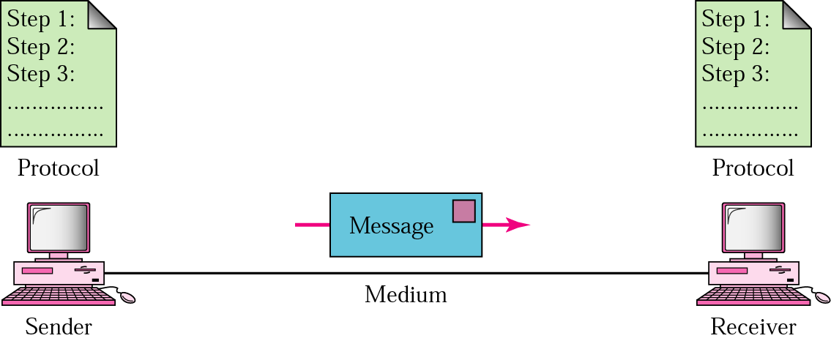
1.2 Overview of Data Communications
  A data communication system has 5 components
  Message: the information to be communicated (text, numbers, pictures, sound, video - or combinations)
  Sender: the device - computer, video camera, …
  Receiver: still the device
  Medium: the physical path by which a message travels from sender to receiver
  Protocol: the set of rules that govern data communications; an agreement between the communicating devices
AcK: Most drawings in all slides are taken from Forouzan and some from Tanenbaum

Slide 6
Direction of data flow can be
  Simplex: unidirectional, only one of the devices can transmit
  Half-duplex: both can transmit and receive, but not at the same time
  Full-duplex: both can transmit and receive at the same time
Network Criteria
  Performance: can be measured using transit time (amount of time required for a message to travel) and response time (elapsed time between an inquiry and the response)
  Reliability: measured by the frequency of failure, the time it takes a link to recover from failure, and the network’s robustness in a catastrophe
  Security: protecting data from unauthorized access

Slide 7
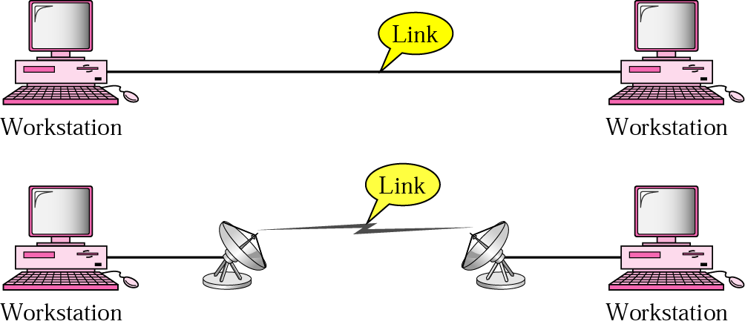
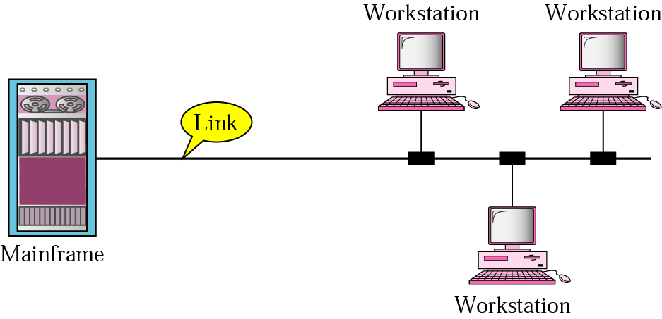
Types of connection
  Point-to-point: provides a dedicated link between two devices
  Multipoint: more than two devices share a single link (spatially - simultaneously - or temporally by taking turns)

Slide 8
Physical Topology (for LANs)
  refers to the way in which a network is laid out physically
  two or more devices connect to a link; two or more links form a topology
  four basic topologies are possible: mesh, star, bus, ring

Slide 9
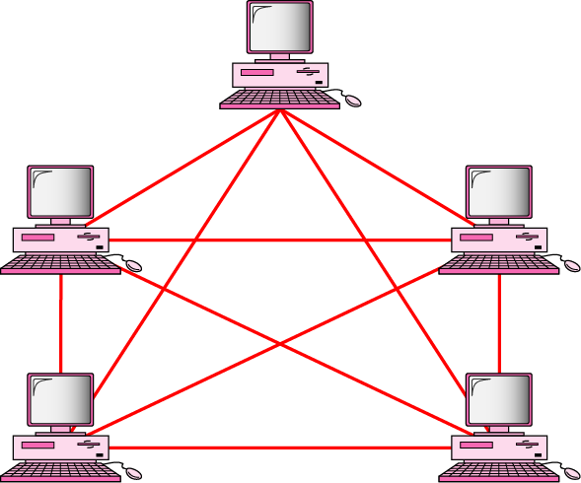
Mesh
  every device has a dedicated point-to-point link to every other device
  every device must have n-1 I/O ports, where n is the number of devices connected
  advantages
    no traffic problem (no congestion)
    robust; a failure of a link has no effect on others
    fault identification and isolation are easy
    privacy or security (provided there is no wire tapping)
  disadvantages
    amount of cabling and I/O ports needed (expensive)

Slide 10
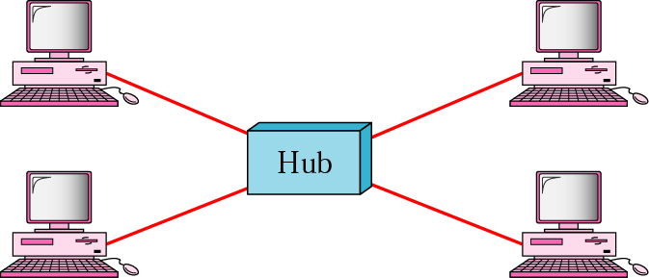
Star
  each device has a dedicated point-to-point link only to a central controller, usually called a hub
  advantages
    robust; a failure of a link has no effect on others
    fault identification and isolation are easy
    less expensive than mesh (but more expensive than others)
  disadvantage
    failure of the hub halts the system (single point of failure)

Slide 11
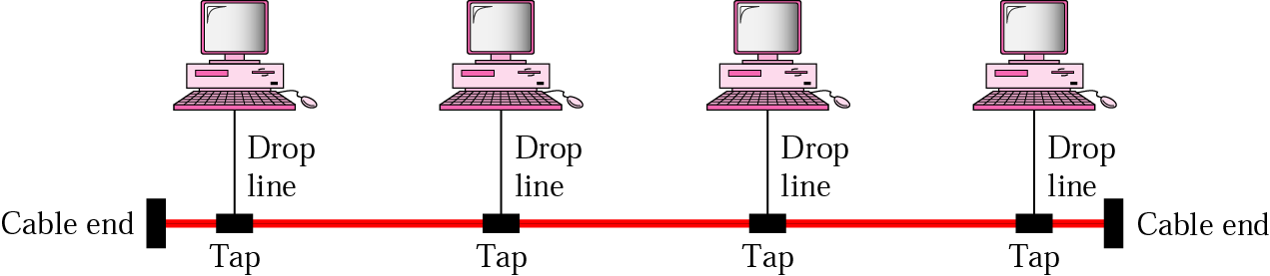
Bus
  multipoint (one long cable acts as a backbone to link all the devices in the network)
  advantages
    ease of installation; less cabling than star or mesh
  disadvantages
    signal reflection at the taps can cause degradation in quality (solution: limit the number and spacing of devices connected to a given length of cable)
    difficult reconnection (adding new devices) and fault isolation
    a fault in the bus cable stops all transmission

Slide 12
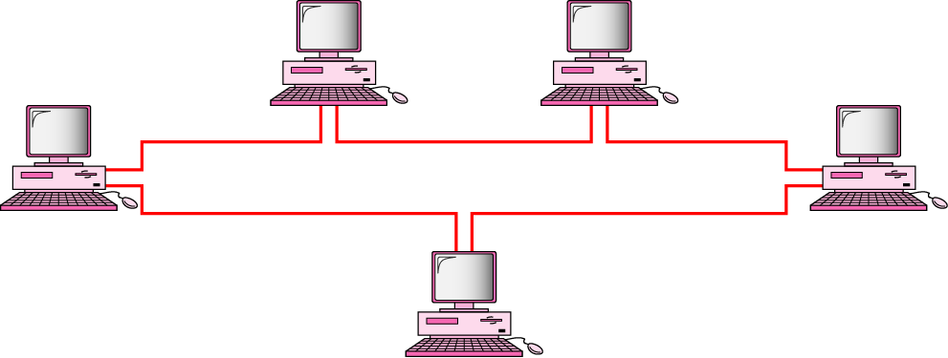
Ring
  each device has a dedicated point-to-point connection only with the two devices on either side of it
  a signal is passed along the ring in one direction, from device to device, until it reaches its destination
  each device incorporates a repeater (to regenerate bits received before passing it)

Slide 13
  advantages
    relatively easy to install and configure - adding or deleting a device requires changing only two connections
    fault isolation is simplified (if one device does not receive a signal within a specified period, it can issue an alarm)
  disadvantages
    a break in the ring (such as a disabled station) can disable the entire network

Slide 14
Network Categories: based on size, ownership, the distance it covers, and its physical architecture
  Personal Area Network (PAN): meant for one person; e.g. a wireless network connecting a computer with its mouse, keyboard and printer
  Local Area Network (LAN): usually privately owned and links devices in a single office, building or campus
    User rates: 10 Mbps – 1 Gbps
    e.g., Ethernet, Token ring, Apple-talk
  Metropolitan Area Network (MAN): designed to extend over an entire city; it may be a single network or interconnected LANs
  Wide Area Network (WAN): covering large geographic area; may utilize public, leased, or private communications equipment
    1980’s: 10 Kbps; 2000’s: 2.5 Gbps
    user access rates: 56 Kbps - 155 Mbps

Slide 15
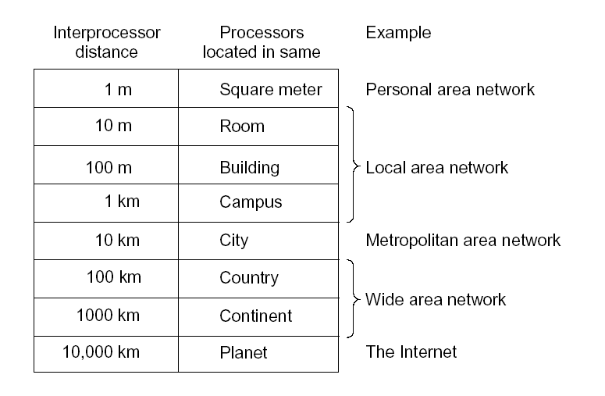

Slide 16
The Internet
  when two or more networks are connected, they become an internetwork, or internet
  the most notable internet is called the Internet, a collaboration of more than hundreds of thousands of interconnected networks
  it came into being in 1969 - by ARPA (Advanced Research Project Agency) of DoD for researchers they funded to share findings
  it developed a packet-switched network, named as the ARPANET

Slide 17
by the mid-seventies, a full suite of protocols, called TCP were developed and proposed as the standard underlying technology for the expanded use of the ARPANET system
TCP was later split into two protocols: IP to handle datagram routing and TCP to be responsible for higher-level functions such as segmentation, reassembly, and error correction; it was named as TCP/IP and was adopted as the standard protocol suite in 1983
addressing used by ARPANET users became easier to handle in 1984 with the development of the Domain Name System (DNS); this service took the responsibility of putting ARPANET numerical address into readable text form and is still in use
in the 1990s, an international consortium under the name of European Center for Nuclear research (CERN) created the concept of web pages and the WWW that allowed the exchange of data on the Internet with ease - Tim Berners-Lee

Slide 18
Search Engines: ARCHIE (the first) was introduced at McGill University; followed by gopher (1991, University of Michigan), VERONICA (1993, McGill); today we have such search engines like AltaVista, Yahoo, Google, etc.
HTML was developed in 1992
Web Browsers: mosaic (the first graphical web browser) was developed in 1993 by students at the national center for super computing at the university of Illinois; today we have browsers like Netscape (although it is dying against my wish), Internet Explorer, and Firefox
the Internet today
  end users use the services of ISPs
  there are international ISPs that connect nations, regional, and national ISPs
  NAP - Network Access Points connect backbone networks of IISPs

Slide 19
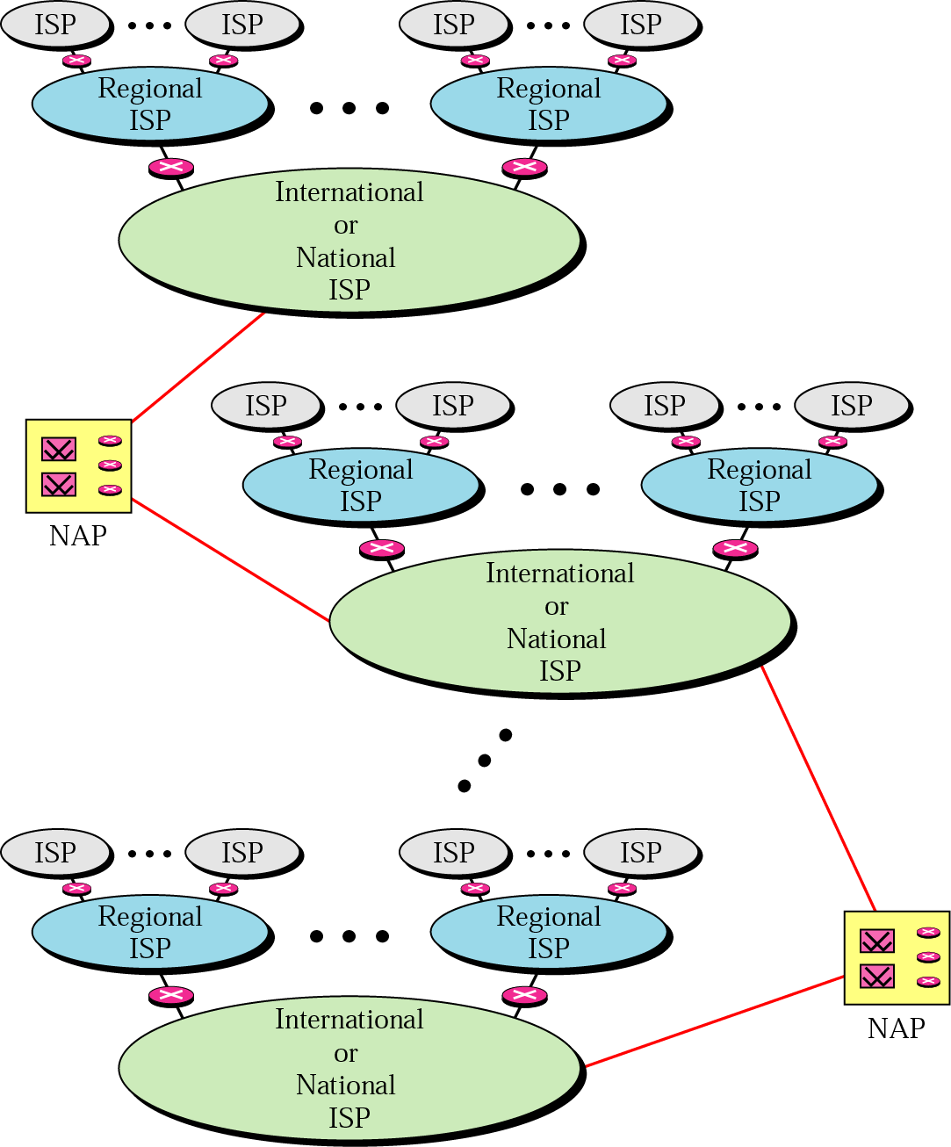
old figures
The number of Internet hosts advertised in the DNS rose from 1,313,000 in January 1993 to 625,226,456 in January 2009, an average annual increase of 150%; in the sixteen-year period between 1993 and 2009, the absolute increase in the number of Internet hosts is 47,618%!
Do you know that 80% of the web sites are in the USA?
What is the picture in Ethiopia?

Slide 20
1.3 Network Protocols and Standards
  a protocol is a set of rules that governs data communications
  a protocol defines what is communicated, how it is communicated, and when it is communicated
  for instance, for one computer to send a message to another computer, the first computer must perform the following general steps
    break the data into small sections called packets
    add addressing information to the packets identifying the source and destination computers
    deliver the data to the network interface card for transmission over the network

Slide 21
  the receiving computer must perform the same steps, but in reverse order
    accept the data from the NIC
    remove transmitting information that was added by the transmitting computer
    reassemble the packets of data into the original message
  the key elements of a protocol are syntax, semantics, and timing
    syntax: refers to the structure or format of the data
    semantics: refers to the meaning of each section of bits
    timing: refers to when data should be sent and how fast they can be sent
functions of protocols
  each device must perform the same steps the same way so that the data will arrive and reassemble properly; if one device uses a protocol with different steps, the two devices will not be able to communicate with each other

Slide 22
  the following are categories of functions that form the basis of protocols
    encapsulation
    segmentation and reassembly
    connection control
    addressing
    multiplexing
    transmission services
Encapsulation
  the inclusion of control information to data is called encapsulation. Each frame contains not only data but also control information
    such control information falls into three categories: address (sender/receiver), error-detecting code and protocol control (information about protocol functions)

Slide 23
Segmentation (by the sender also called fragmentation) and reassembly (by the receiver)
  a block of data for transmission is of some bounded size
  at the application level, we refer to a logical unit of data transfer as a message
  lower level protocols may need to break the data up into blocks of some bounded size
  this process is called segmentation
  reasons for segmentation:
    the communication network may only accept blocks of data up to a certain size
    error control may be more efficient with a smaller frame size; fewer bits need to be retransmitted when a frame gets corrupted
    facilitates more equitable access to shared transmission facilities (for example, without maximum block size, one station could monopolize a multipoint medium)

Slide 24
  disadvantages
    since a frame contains certain amount of control information, the smaller the block size, the greater the percentage overhead
    frame arrivals may generate an interrupt that must be serviced; hence smaller blocks result in more interrupts
    more time is spent processing smaller, more numerous frames
  the counterpart of segmentation is reassembly
    on receipt, the receiving device must reassemble the segmented data into a message appropriate to the application

Slide 25
Connection control
  two types of protocols (services)
    Driving own car vs taking a taxi or Anbessa Autobus
    connectionless service
      the packets are sent from one party to another with no need for connection establishment or connection release
      the packets are not numbered, they may be delayed, lost, or arrive out of sequence; there is no acknowledgement either
      UDP (User Datagram Protocol), one of the transport layer protocols, is connectionless
      good for one time transaction; e.g., email

Slide 26
  connection-oriented service
    in connection-oriented data transfer, a logical association or connection is established between the communicating computers (devices)
    long sustained session
    orderly and timely delivery of packets, e.g., FTP
    TCP (Transmission Control Protocol) is connection-oriented
    three phases are involved
      connection establishment (agreement to exchange data)
      data transfer (data and control information exchanged)
      connection termination (termination request) - by any of the two parties
    the key characteristics of connection-oriented data transfer is that sequencing is used
    each side sequentially numbers the frames that it sends to the other side

Slide 27
  because each side remembers that it is engaged in a logical connection, it can keep track of both outgoing numbers, which it generates, and incoming numbers which are generated by the other side
  sequencing supports three main functions
    ordered delivery: frames may not arrive in the order in which they were sent, because they may traverse different paths
    flow control: a receiving station has to limit the amount or rate of data that is sent by a transmitting station
      the simplest form of flow control is stop-and-wait procedure in which each frame must be acknowledged before the next can be sent
      more efficient protocols involve some form of credit provided to the transmitter, which is the amount of frames that can be transmitted without an acknowledgement; e.g. sliding window technique

Slide 28
  error control: error control is implemented as two separate functions; error detection and retransmission
    if an error is detected, the receiver discards the frame
    upon failing to receive an acknowledgement to the frame in a specified reasonable time, the sender retransmits the frame
    some protocols also employ error correction which enables the receiver not only to detect errors but, in some cases, to correct them
  we will study some details of flow control and error control again in the data link layer and in TCP
addressing
  a unique address is associated with each end-system in a configuration (e.g. workstation, server) and each intermediate system (e.g. router)
  an example is an IP address in TCP/IP connection, but addressing spans more layers: data link, network, transport

Slide 29
multiplexing
  occurs when multiple connections share a single connection (multiple access)
transmission services
  a variety of additional services can be provided
  priority: messages such as control messages may need to get through to the destination station with minimum delay
  security: security mechanisms, restricting access, may be invoked

Slide 30
Protocols in a layered architecture
  protocols that work together to provide a layer or layers of the model are known as a protocol stack or suite, e.g. TCP/IP
  each layer handles a different part of the communications process and has its own protocol
Data Communication Standards
  standards are essential for interoperability
  data communication standards fall into two categories
    De facto standards: that have not been approved by an organized body; mostly set by manufacturers
    De jure standards: those legislated by an officially recognized body such as ISO, ITU, ANSI, IEEE

Slide 31
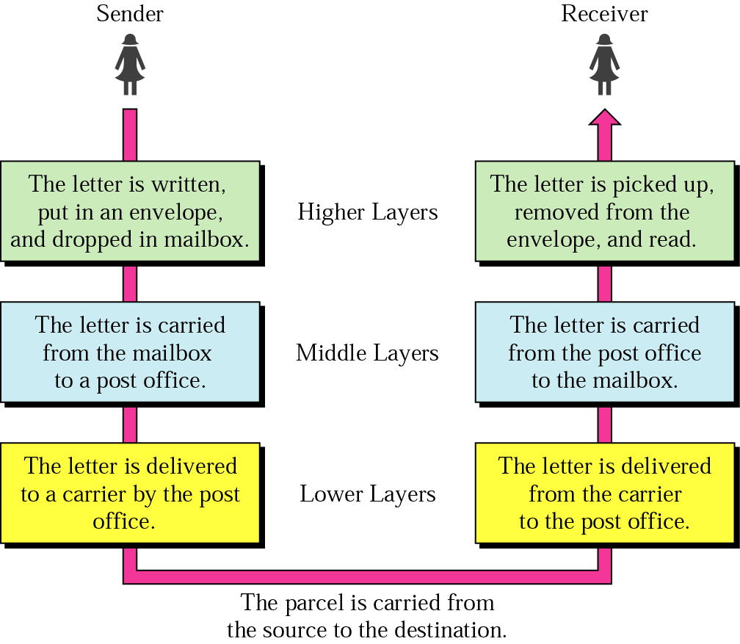
1.4 Network (Reference) Models
  Consider an example of sending a letter

Slide 32
Hierarchy
  there are three different activities at the sender side and another three at the receiver’s side
  the tasks must be done in the order given in the hierarchy
Layers and Services
  within a single machine, each layer uses the services immediately below it and provides services for the layer immediately above it
  between machines, layer x on one machine communicates with layer x on another machine

Slide 33
Why layering?
  reduces complexity (one big problem to smaller ones)
  standardizes interfaces (between layers)
  facilitates modular engineering (different teams work on different modules)
  assures interoperable technology
  accelerates evolution of networking technology
  simplifies teaching and learning

Slide 34
Two important network models or architectures
  The ISO OSI (Open Systems Interconnection) Reference Model
  The TCP/IP Reference Model
a. The OSI Reference Model
  consists of 7 layers
  was never fully implemented as a protocol stack, but a good theoretical model
  Open – to connect open systems or systems that are open for communication with other systems

Slide 35
Principles to arrive at the 7 layers
  a layer should be created at different level of abstraction
  a layer should perform a well-defined function
  the function of each layer should be chosen towards defining internationally standardized protocols
  layer boundaries should be chosen to minimize the information flow across the interfaces
  the number of layers should be optimal
    large enough so that distinct functions should not be put together, and
    small enough so that the architecture does not become unwieldy

Slide 36
b. The TCP/IP Reference Model
  TCP/IP - Transmission Control Protocol/Internet Protocol
  used by ARPANET and its successor the Internet
  design goals
    the ability to connect multiple networks (internetworking) in a seamless way
    the network should be able to survive loss of subnet hardware, i.e., the connection must remain intact as long as the source and destination machines are properly functioning
    flexible architecture to accommodate requirements of different applications - ranging from transferring files to real-time speech transmission
  these requirements led to the choice of a packet-switching network based on a connectionless internetwork layer
  has 4 (or 5 depending on how you see it) layers: Application, Transport, Internet (Internetwork), Host-to-network (some split it into Physical and Data Link)

Slide 37
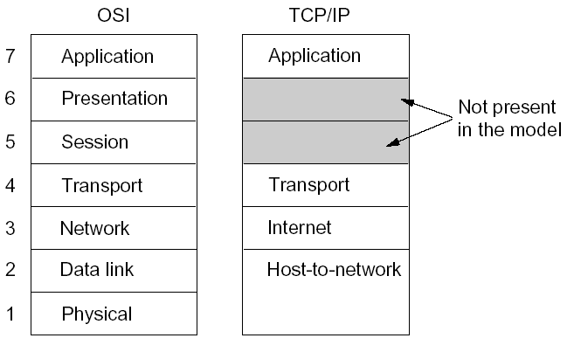
OSI and TCP/IP Layers Correspondence

Slide 38
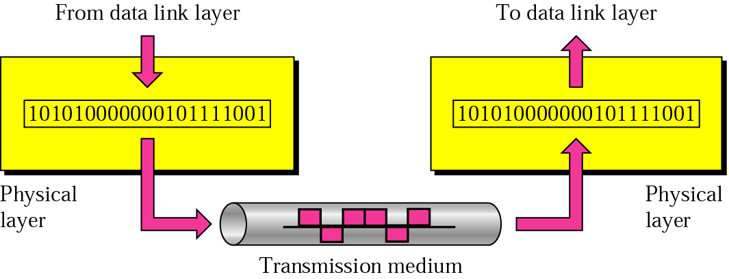
Physical Layer
  responsible for transmitting individual bits from one node to the next
  design issues:
    mechanical: the size and shape of the network connector, how many pins does the network connector has and what each pin is used for
    electrical: how many volts represent a 1 and how many a 0
    timing: how many nanoseconds a bit lasts
    whether communication is one way or in both directions simultaneously

Slide 39
Data Link Layer
  makes the line appear free of undetected transmission errors to the network layer (flow and error control)
  this layer was not required if the underlying transmission media were error free
  how?
    the sender breaks the input data into data frames and transmit them sequentially (numbering them) by adding error detecting codes
    the receiver confirms correct receipt by sending back an acknowledgement frame
  note: the Host-to-network layer in the TCP/IP model is not defined; it simply points out that the host has to connect to the network using some protocol so that it can send IP packets to it

Slide 40
Network Layer (or Internet Layer)
  permits hosts to inject packets into any network and have them travel independently to their destination - possibly on a different network
  allows heterogeneous networks to communicate - addressing, packet size, protocol differences
  arrival order of packets may not be respected - let higher layers do the rearrangement if need be
  similar to the snail mail system - an international mail from country A to country B traveling through one or more international mail gateways transparent to the user and other hidden rules such as stamps, preferred envelope size, delivery rules, …

Slide 41
  decides how packets are routed from source to destination – three mechanisms
    based on static tables,
    can be determined at the start of each conversation,
    can be highly dynamic by deciding a new route for each packet
  controls congestion
  TCP/IP defines an official packet format and protocol called IP for delivering IP packets and routing
  not essential for LANs

Slide 42
Transport Layer
  accepts data from above, splits it up into smaller units if need be, passes them to the network layer, and ensures that the pieces all arrive correctly at the other end
  allows peer entities on the source and destination machines to hold conversations
  in the case of the OSI model, determines types of services to provide to the session layer
    deliver messages in the order they were sent or without guarantee of the order of delivery
    broadcasting messages to multiple destinations

Slide 43
  In the TCP/IP model, two end-to-end transport protocols have been defined
    TCP - Transmission Control Protocol
      a reliable connection-oriented protocol that allows a byte stream to be delivered without error
      handles flow control to make sure that a fast sender does not swamp a slow receiver
    UDP - User Datagram Protocol
      an unreliable, connectionless protocol
      for applications
        that do not want TCP’s sequencing or flow control and wish to provide their own
        where prompt delivery is more important than accurate delivery, e.g., audio and video

Slide 44
Session Layer (OSI model)
  allows users to establish sessions between them
  services include
    dialog control - keeping track of whose turn it is to transmit
    token management - preventing two parties from attempting the same critical operation at the same time
    synchronization - checkpointing long transmissions to allow them to continue from where they were after a crash
    provides access rights, billing functions, etc.
Presentation Layer (OSI model)
  concerned with the syntax and semantics of the information transmitted
  different data structures can be defined in an abstract way so that it is possible for computers with different data representations to communicate
  provides character code conversion, data encryption, data compression

Slide 45
Application Layer
  contains all the higher level protocols that are commonly needed by users; examples are
    HTTP (Hypertext Transfer Protocol) - for fetching pages on the WWW
    TELNET - virtual terminal, to log on to a remote machine
    FTP - file transfer
    SMTP - e-mail
    DNS - for mapping host names onto their network addresses

Slide 46
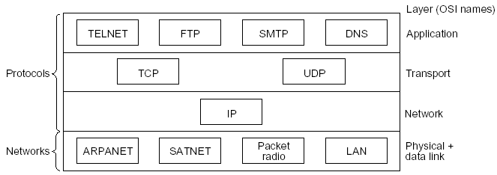
Protocols and Networks in the TCP/IP model initially

Slide 47
Host (upper) Layers
Summary
Application (7): Network services to applications
Presentation (6): Data presentation to applications
Session (5): Managing sessions between applications
Transport (4): End-to-end connection and reliability
Network (3): Managing connections across the network
Data Link (2): Reliable data delivery across the link
Physical (1): Physical characteristics of the media
Media (lower) Layers

Slide 48
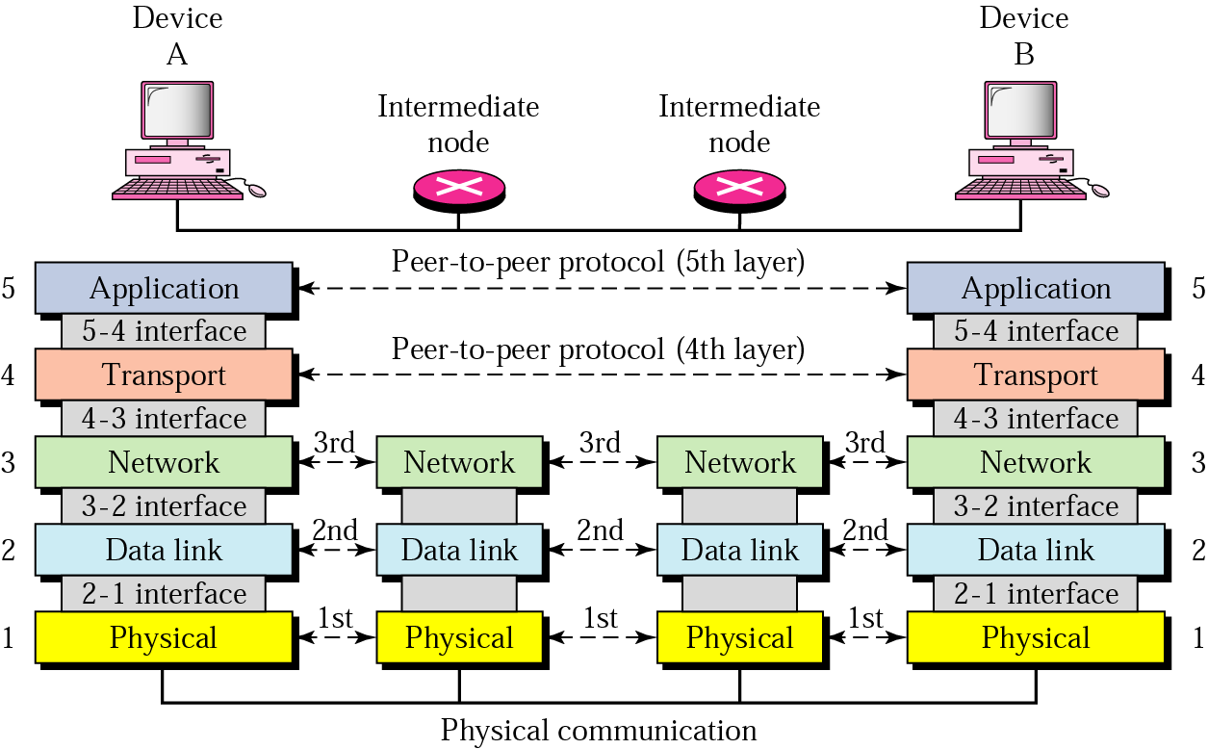
Layers involved in various hosts (TCP/IP)
  when a message is sent from device A to device B, it may pass through many intermediate nodes
  the intermediate nodes usually involve the first three layers

